Slide 1

Susan Massie
Placeholder for Logo
Marketing Director Greyhound Chromatography
Honeywell Research
Chemicals PORTFOLIO

Slide 2

Agenda
Honeywell
Honeywell Research Chemicals
Product Lines Overview
Products for Analytical Chemistry
Products for Oligonucleotide Synthesis

Slide 3


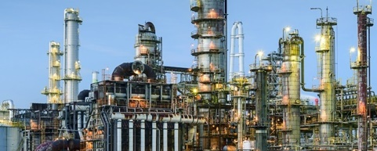

Honeywell Overview
NYSE: HON | ~970 sites | ~110,000 employees | Morris Plains, N.J. headquarters | Fortune 100
For a more detailed overview on Honeywell click here.
Aerospace
Building Technologies
Performance Materials and Technologies
Safety and Productivity Solutions
Our products are used on virtually every commercial and defense aircraft platform worldwide and include aircraft propulsion, cockpit systems, satellite communications, and auxiliary power systems.
Our products, software, and technologies are in more than 10 million buildings worldwide, helping customers ensure their facilities are safe, energy efficient, sustainable, and productive.
We develop advanced materials, process technologies, automation solutions, and industrial software that are revolutionizing industries
around the world.
We improve enterprise performance and worker safety and productivity with our scanning and mobile computers, software, warehouse automation solutions, and personal protective equipment.
Aligned to Key Global Macro Trends

Slide 4
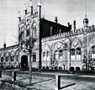

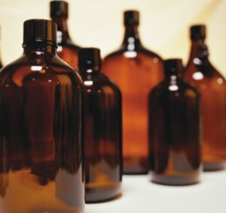
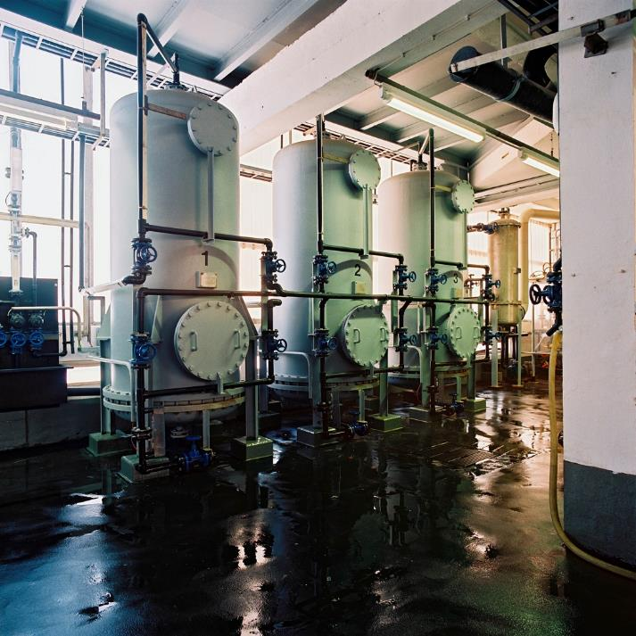
Honeywell Research Chemicals
Pioneer with 200 years
of history in producing chemicals in two plants:
Seelze, Germany
Muskegon, Michigan, USA
Producer of worldwide
known and leading brands
A global portfolio of
than 6,000 references for all needs in analytical and chemistry labs
Our Strengths
Leader in high-purity solvents and Hydranal™ reagents
Best quality material on the market
Competitively priced direct from producer
Exceptional lot-to-lot consistency
Production and QC
Flexibility in custom packaging and blending, including a highly developed returnable containers program
Bulk availability
Broad offer
Notes:
DIRECT

Slide 5
Research Chemicals Business | Background Timeline
Honeywell announces its intention to buy select brands and products from Sigma-Aldrich
Honeywell sales & marketing meet customers and establish partnerships with distribution partners
Honeywell launches
www.lab-Honeywell.com eCommerce platform
Honeywell closes acquisition of selected brands and product lines from Sigma-Aldrich
Distribution centers become operational in Ireland, the UK, France, China, USA, and Germany
Honeywell launches the Research Chemicals business globally
October
2015
December
2015
January
2016
June
2016
October
2016
November/ December
2016

Slide 6




Honeywell Research Chemicals
Brand
Overview | Solvents & Reagents High-purity solvents and reagents | Solvents High-purity solvents | Analytical Reagents Karl Fischer titration, standards, acids, bases, salts, and pH buffers | Performance Grade Solvents and inorganics for general laboratory use
Product Lines | BioSyn™ - DNA/RNA and peptide synthesis B&J Brand - Chromatography, spectrometry, synthesis and combinatorial chemistry B&J GC² - Gas chromatography Anhydrous - Organic synthesis, organometallic, and combinatorial chemistry Honeywell LabReady™ Blends B&J Purified Plus | Chromasolv™ - Chromatography (LC-MS, UHPLC, GC and GC headspace ) Spectroscopy - IR and UV-Vis applications ACS and Pharmacopoeia Grade - Industrial and pharmaceutical applications TraceSELECT™ Solvents - Trace and low-metal content analysis | Acids/bases, salts Analytical Standards Buffers and Volumetric Solutions - Concentrates and ready-to-use Hydranal™ - Reagents and standards for Karl Fischer titration TraceSELECT™ Inorganics - Trace and low-metal content analysis Consumables for purification (SPE, QuEChERS) | Solvents - ACS specific use (HPLC), ACS general use, histology, and reagent grade for other industrial applications Inorganics - Inorganic chemistry including essential acids and bases, salts, metals and elements, and reagents for chemical reactions
Services & Technology | Returnable Container Program for B&J solvents and BioSyn™ Solvents and Blends Honeywell LabReady™ Blends customer-specific blends using proprietary, closed-loop blending technology | Returnable Container Program reduces carbon footprint while saving time and money Honeywell LabReady™ Blends customer-specific blends using proprietary, closed-loop blending technology | Special Packaging Technology ampoules, bottles, VOLPAC containers | Scalable to Production Requirements Supply in larger quantities

Slide 7
Two Production Plants
Seelze
Germany
Muskegon
Michigan, USA
> 485,000 m²
> 34,000 m²
TS 16949, ISO 9001, ISO 14001, OSHA 18001,
and ISO 50001 accredited
Hydranal™ reagent production
Chromasolv™ and TraceSelect™ solvents production
Volumetric Solutions production
Returnable Container Program
ISO 900, ISO 14001 certified
Burdick & Jackson™ and Chromasolv™ solvents production
Returnable Container Program

Slide 8
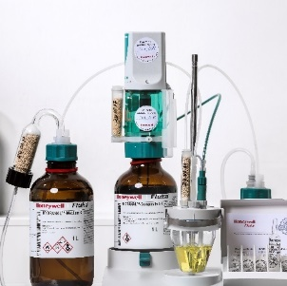
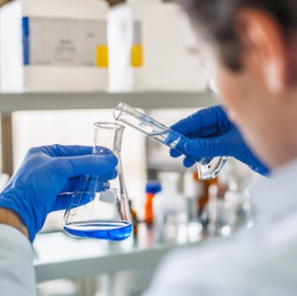
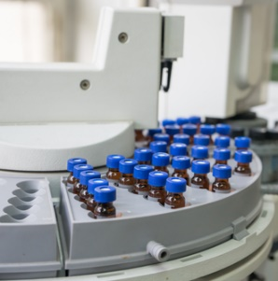

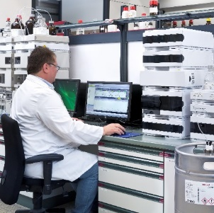

High-quality Reagents and Chemicals for Analytical Applications
Analytical Reagents
Karl Fischer
Titration
Volumetric
Titration
Gas
Chromatography
Honeywell
Research
Chemicals
Wet
Chemistry
Standards
Liquid
Chromatography
Spectroscopy &
Spectrometry
Solvents

Slide 9
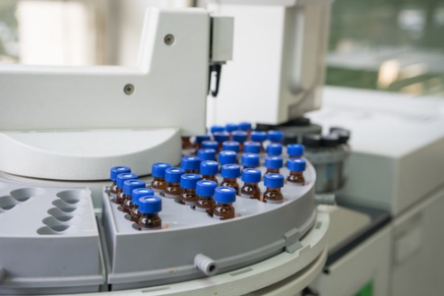



Gas Chromatography (GC)
Solvents
In various grades for various applications
A variety of packaging solutions, including stainless steel returnable drums
Made to the original specifications that guarantee exceptional purity and lot-to-lot consistency
Burdick & Jackson™ solvents
High purity solvent for various applications (Low trace impurities, low water content and low particulate levels)
Chromasolv™ solvents for residue analysis of pesticides and other low-volatile substances using GC, e.g. dioxins, furans and PCB
Non-volatile matter and water content specified
Burdick & Jackson™ GC² solvents
Solvents for environmental analysis such as capillary gas chromatography applications requiring trace analysis at or below the part-per-billion level
Ideal for EPA protocols.
Chromasolv™ GC-headspace solvents
For identification/quantification of residual solvents in pharmaceuticals using GC-headspace methods
Meet USP, Ph. Eur. and ICH requirements
GC headspace application tested
Packed under inert gas for longer shelf life

Slide 10
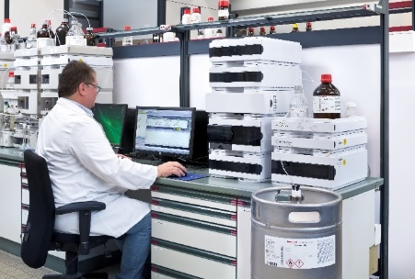

Liquid Chromatography (HPLC, LC-MS, UHPLC)
Solvents
In various grades for various applications
A variety of packaging solutions, including stainless steel returnable drums
Made to the original specifications that guarantee exceptional purity and lot-to-lot consistency
Chromasolv™ solvents
for HPLC, gradient grade, Plus for HPLC, LC-MS, LC-MS Ultra, UHPLC
Burdick & Jackson™ solvents
for ACS specific use, HPLC, and LC-MS
Honeywell LabReady™ Blends
for HPLC and LC-MS
Additives and Buffers
Specifically tested for HPLC applications
Many varieties of solvents, acids and salts
Analytical Standards
For different industry specific applications
Technical service
Eluent additives for HPLC, LC-MS, and UHPLC
Suitable for LC-MS applications

Slide 11
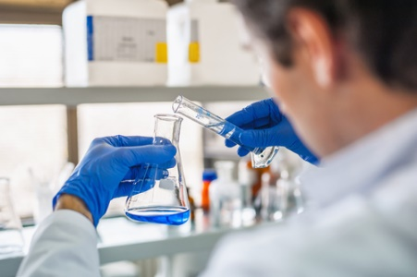
Volumetric Titration
High-quality Reagents, Solutions and Indicators for Volumetric Titration
Volumetric Standard Solutions
Acids, bases or salts for acidimetric, alkalimetric, redox and precipitation titration methods
Ready-to-use solutions in plastic bottles or in 5 or 10 L VOLPAC™ containers
Concentrates in ampoules or bottles and can be used directly after dilution
pH Buffers
Buffers ranging from pH 1.00 – 13.00
Color-coded buffers pH 4 (red), 7 (green),
9 (blue), 10 (violet)
High precision buffers according to DIN 19266
Available as ready-to-use solutions and concentrates
Certified pH buffers, traceable to SRM from NIST
Indicators
Powders and solutions for acid-base, adsorption, redox and metal titration, as well as indicators for non-aqueous titration
Reagents for Complexometry
Aminopolycarboxylic acids
(EDTA/NTA analogs)
Masking agents

Slide 12
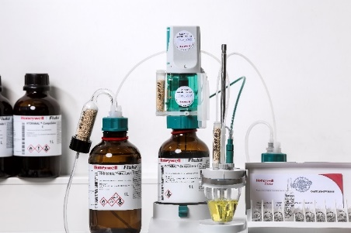

Karl Fischer Titration
Methanol and ethanol-based KF reagents free from pyridine
The world-leading product line for Karl Fischer water titration with 40 years of experience
Lab Report data base with more than 700 application examples
Hydranal Center for Excellence provides technical support
Reagents for Volumetric Titration
One component and two component reagents
Hydranal-Methanol Rapid containing accelerators to speed up titration with
one-component reagents
Hydranal E-Type reagents based on ethanol for safer titrations
Hydranal-Medium K for the determination of water in aldehydes and ketones
Reagents for Coulometric Titration
Hydranal-Coulomat A-type or E-type reagents (anolytes)
Hydranal-Coulomat CG reagents (catholytes)
Water Standards
Exactly determined water content for titer determination, monitoring analysis precision and accuracy, and validation and control of KF titrators
Hydranal™ Certified Reference Materials (CRMs) traceable to other internationally accepted standards
Auxiliaries
Solubilizers, buffers, drying agents, Moisture Test Kit

Slide 13


Wet Chemistry
Consistent analytical reagents and laboratory essentials
Acids/Bases
Basic Honeywell-branded grades to ultra-pure TraceSELECT™ grades for sample decomposition, metal dissolution, or sample mineralization
Salts
Basic Honeywell-branded grades to ultra-pure TraceSELECT™ grades
Adsorbents
Silica gels, molecular sieves, activated alumina, activated carbon, ion exchange resins, charcoal, vermiculite, sand, etc.
For chromatography, purification, drying agent, desiccant, catalysis
Reagents and Solvents for ACS and/or Pharmacopeia Testing
Acids, basis, salts, volumetric solutions and solvents meet specifications of the corresponding monograph

Slide 14

Spectroscopy & Spectrometry
Solvents and reagents providing the purity you need for your spectroscopy and spectrometry applications
Solvents & Reagents
For IR and UV-Vis applications
High spectral purity (minimal fluorescence, water, evaporation residue, acidity, alkalinity)
TraceSelect™ Acids, Bases and Salts
For sample digestion of dissolution for
  Inductively coupled plasma atomic emission spectroscopy (ICP-OES)
  Inductively coupled plasma mass spectrometry (ICP-MS)
  Flame atomic absorption spectroscopy (AAS)
  Graphite furnace AAS
High purity reagents with very low metal content for ultra-trace analysis at ppb and even ppt levels

Slide 15


Honeywell B&J Reagents and Solvents for Oligo and Peptide Synthesis – NA/ APAC only
Honeywell B&J BioSyn™ Reagents
Honeywell Research Chemicals
Honeywell B&J BioSyn™ Solvents

Slide 16


BioSyn™ Reagents
Reagents for DNA and RNA synthesis including reagents for:
  Deblocking
  Activation
  Capping
  Oxidation
  Washing
Submicron filtration used to minimize particle contamination
Package sizes from 1L glass bottles to 1,250L bulk containers
Packaging is designed to facilitate direct connection to popular synthesizers
Various standard formulations available and in-house capability to make custom reagents and formulations
High purity reagents to ensure improved over-all yield of final products

Slide 17

BioSyn™ Solvents or Related Products
Submicron filtration used to minimize particle contamination
Package sizes from 1L glass bottles to 1,250L bulk containers
Packaging is designed to facilitate direct connection to popular synthesizers
Manufactured to have low water content
Solvents and reagents have been use tested in various oligonucleotide synthesis and production applications
A variety of neat solvent specially manufactured for biosynthesis applications
  Acetonitrile
  Dichloromethane
  Pyridine
  Tetrahydrofuran
  Triethylamine
  Trifluoroacetic acid

Slide 18
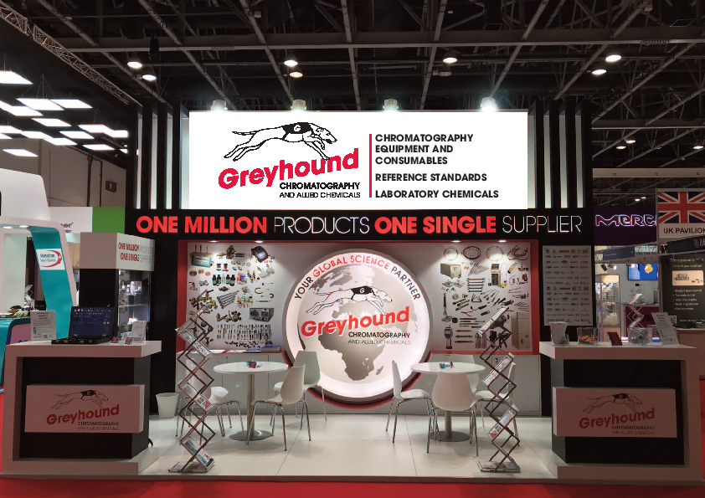
Greyhound Chromatography Company Profile
Company Description
Greyhound Chromatography has been supplying high quality chromatography consumables to Research and Analysis laboratories around the world for 39 years. Greyhound’s Managing Director, Paul Massie, founded the company which operates from its UK facility, located in Birkenhead, Merseyside.
Greyhound Chromatography is a leading global manufacturer and distributor of the highest quality chromatography columns, certified reference standards
and materials, research chemicals, solvents, reagents, and laboratory consumables available today. Greyhound supplies scientists working in all disciplines, including HPLC and Gas Chromatography.
Greyhound Chromatography is probably the leading single source of chromatography products and chemical standards anywhere in the world.
Major Products/Services
Analytical syringes, balances and scales, organic/inorganic reference standards and materials, diluters and dispensers, fittings, flash cartridges, gas filters, gas purifiers/filters/traps, gas regulators, GC columns, GC derivatisation reagents, GC ferrules; seals & inlet liners, HPLC columns; pumps, column heaters & lamps, maintenance tools, membrane filters, TLC consumables, pipettes and tips, prep silica, reagents, solvents, solvent safety solutions, SPE cartridges, syringe accessories, syringe filters, tubing, valves, vials/caps/septa, vial accessories, well plates.
Chief Chromatographic Techniques Supported
All chromatography techniques including:
Chiral chromatography
Derivatives analysis
Environmental analysis
GC and GC-MS
LC-MS
HPLC and UHPLC
ICP, ICP-MS
AA (Atomic Adsorption) spectroscopy
Ion chromatography
SPE and SPME
TLC
WWW.GREYHOUNDCHROM.COM

Slide 19
Greyhound Chromatography Company Prolfile
Markets Served
Testing reference standards, chemicals, solvents
and reagents, laboratory consumables, for analysis and research & development laboratories:
Cosmetics
Environmental: water, air, soil
Energy: electricity, gas, solar, atomic, renewables
Food
Fragrance: including additives to consumer products
Chemical: anything classed as a chemical that is present in the manufacture or use of consumables
Petrochemical: oil, gas, petroleum
Pharmaceutical: testing standards
Facilities
Greyhound Chromatography operates from a warehouse and office facility, with 5,500 sq ft capacity. Approx. 3,500 sq ft
are used as warehouse storage with temperature controlled zones that include refrigerators and a freezer for product storage. Temperatures are recorded and monitored. An external temperature-controlled container is used to store flammable liquids

Slide 20

Greyhound Chromatography and Allied Chemicals
CONTACT INFORMATION
Address:
6 Kelvin Park, Birkenhead, Merseyside, CH41 1LT, UK
Tel: +44 (0) 151 649 4000 Fax: +44 (0) 151 649 4001
Email: info@greyhoundchrom.com
Sales: sales@greyhoundchrom.com Orders: orders@greyhoundchrom.com
WWW.GREYHOUNDCHROM.COM

Slide 21

Thank You
Distributor’s Name: Greyhound Chromatography Email:sales@greyhoundchrom.com Phone No: +44 (0) 151 649 4000
Placeholder for Logo

